Slide 1
Food Blog
Task - 3

Slide 2


Food Blog
A journal-like blogging website to document a range of food-related content, such as restaurant reviews, recipes, memories, and history of local food. The application presents blogs in a chronological order and includes a relatively simple but effective filtering system.
LMS Username | Name | Batch
au910020104005 | Akshitha V A | CC2
au910020104016 | Jhankit K P | CC2
au910020104018 | Karthick Kumar P | CC2
au910020104037 | Ramana A | CC2

Slide 3
Task 3 :: Frontend Creation
Create various Front End Programs
Draw and design a uniform front end code for Food Blog
Draw and design a interactive front end code for Food Blog
Evaluation Metric:
100% Completion of the above tasks
Learning outcome
Developing complicated UI using HTML components
Using props drilling and context to pass variables
Getting familiar with different type of api calls
Handling different input data

Slide 4

Step-Wise Description
1. The following components were created in the React source folder:
Header
Post
Edit Post page
Create Post page
Login page
Register page
Index page
A button component was created with onClick handler for Login and Register page.
Here, the Index page acts as the main component.
The posts, that is, blogs are stored in a json file.

Slide 5
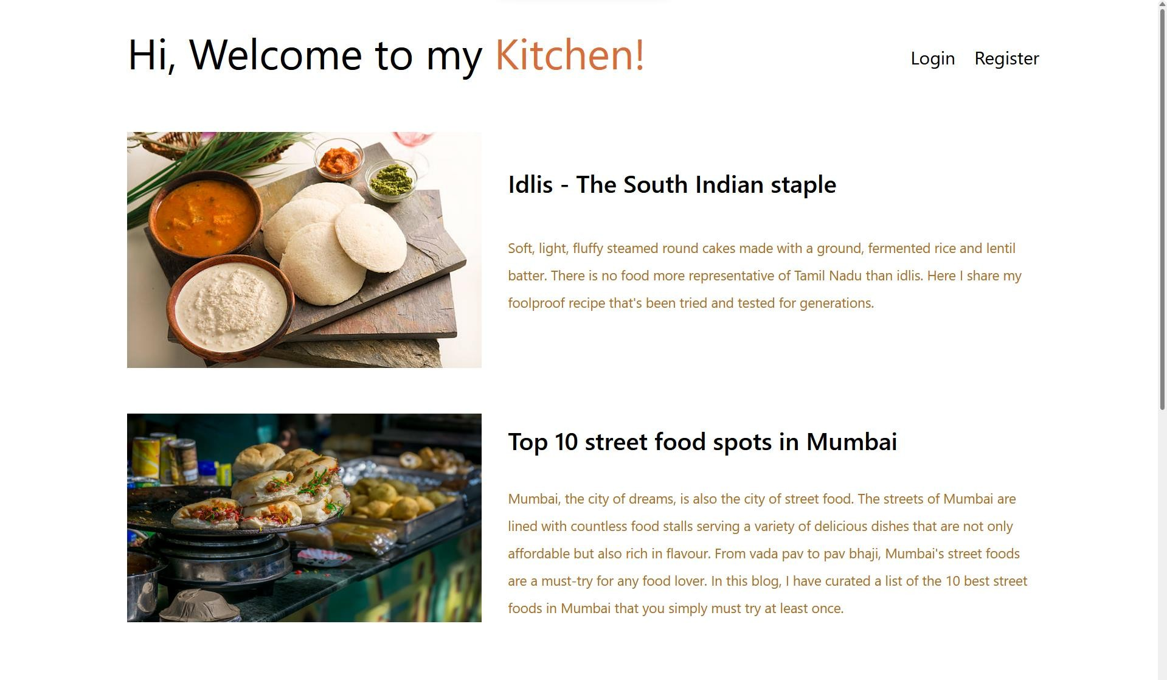
Index Page

Slide 6
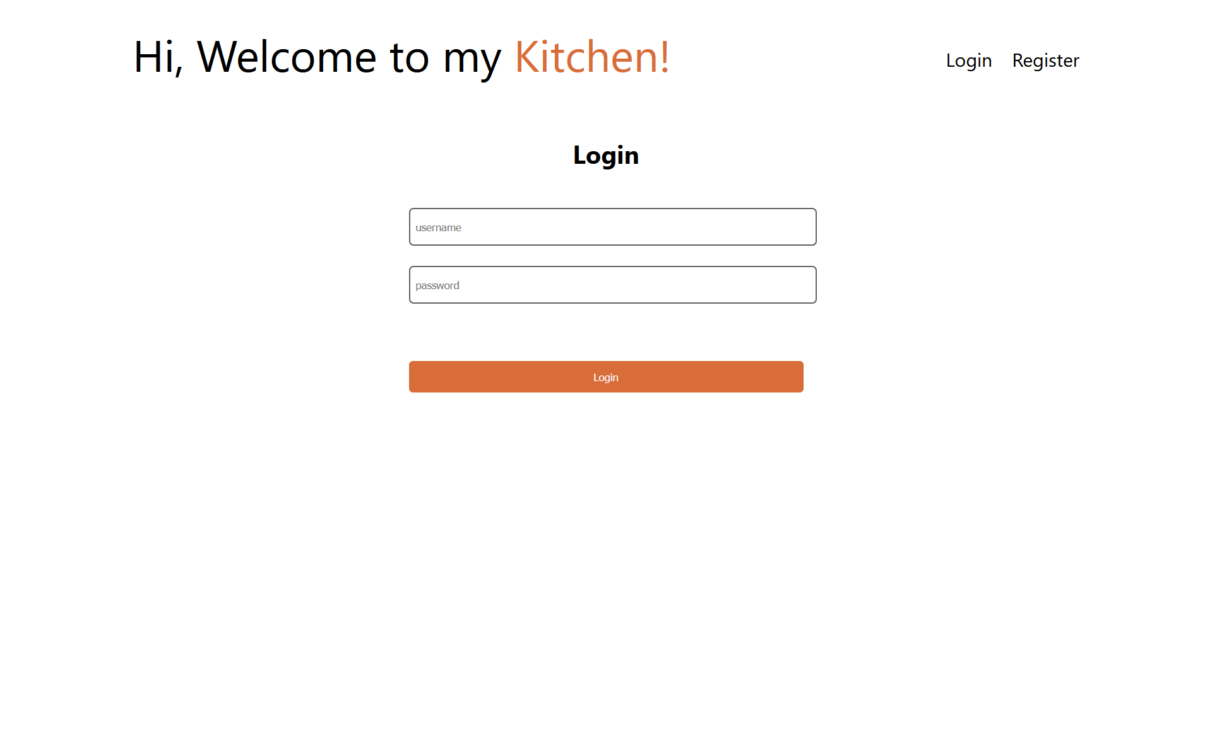
Login Page

Slide 7
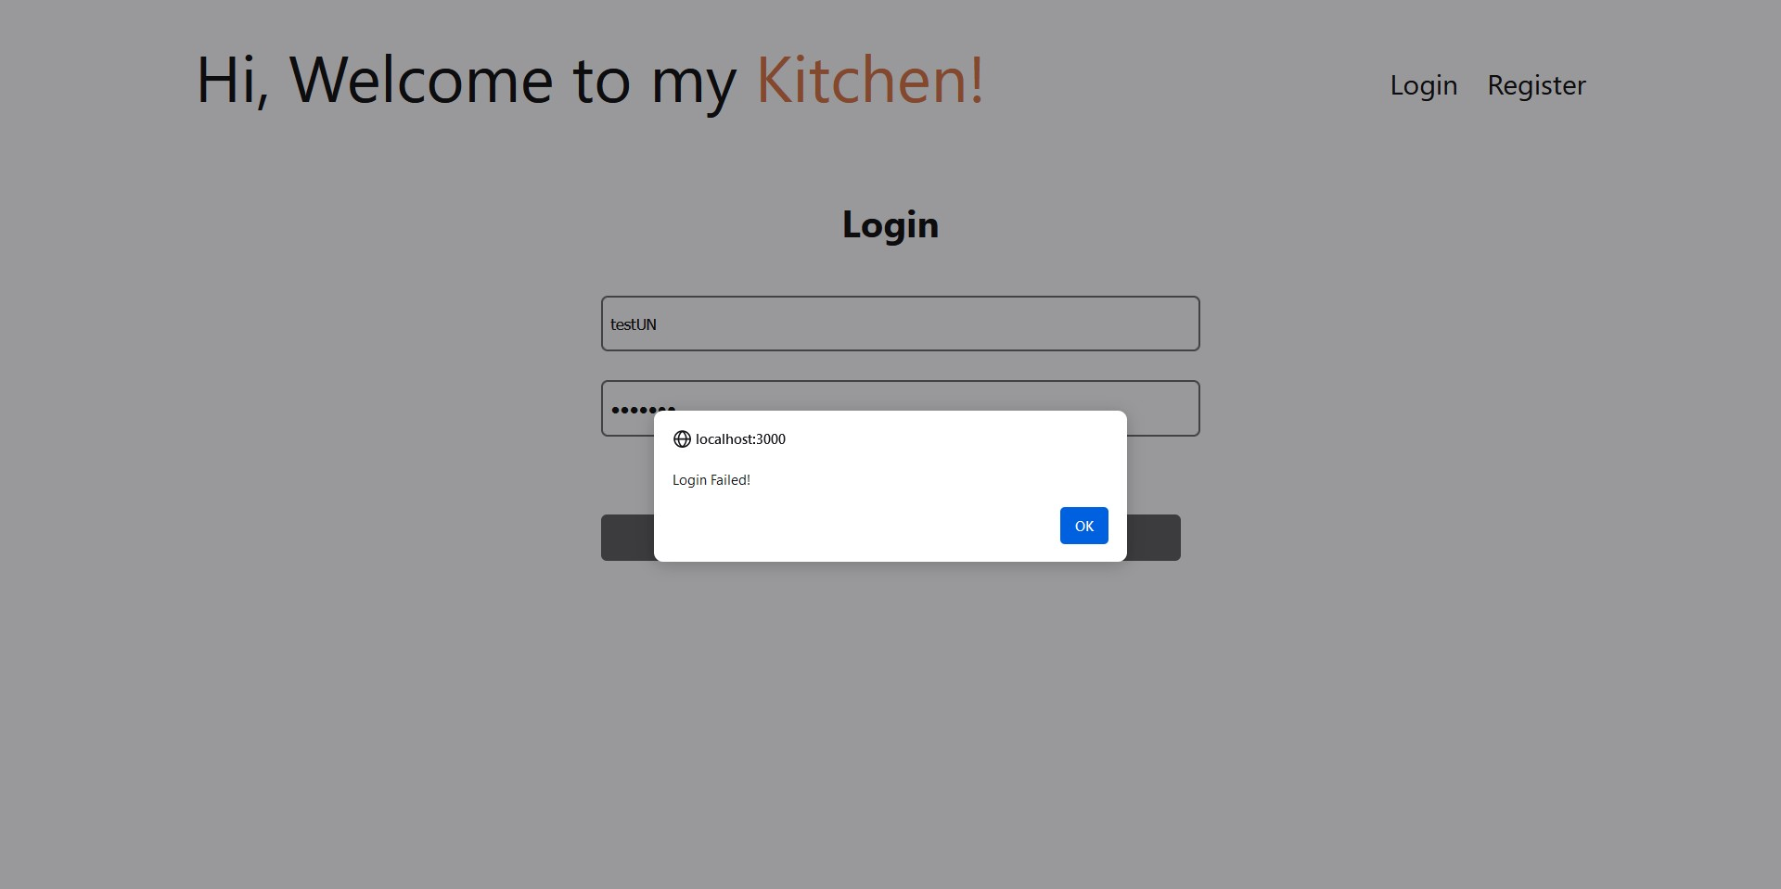
Login Page

Slide 8
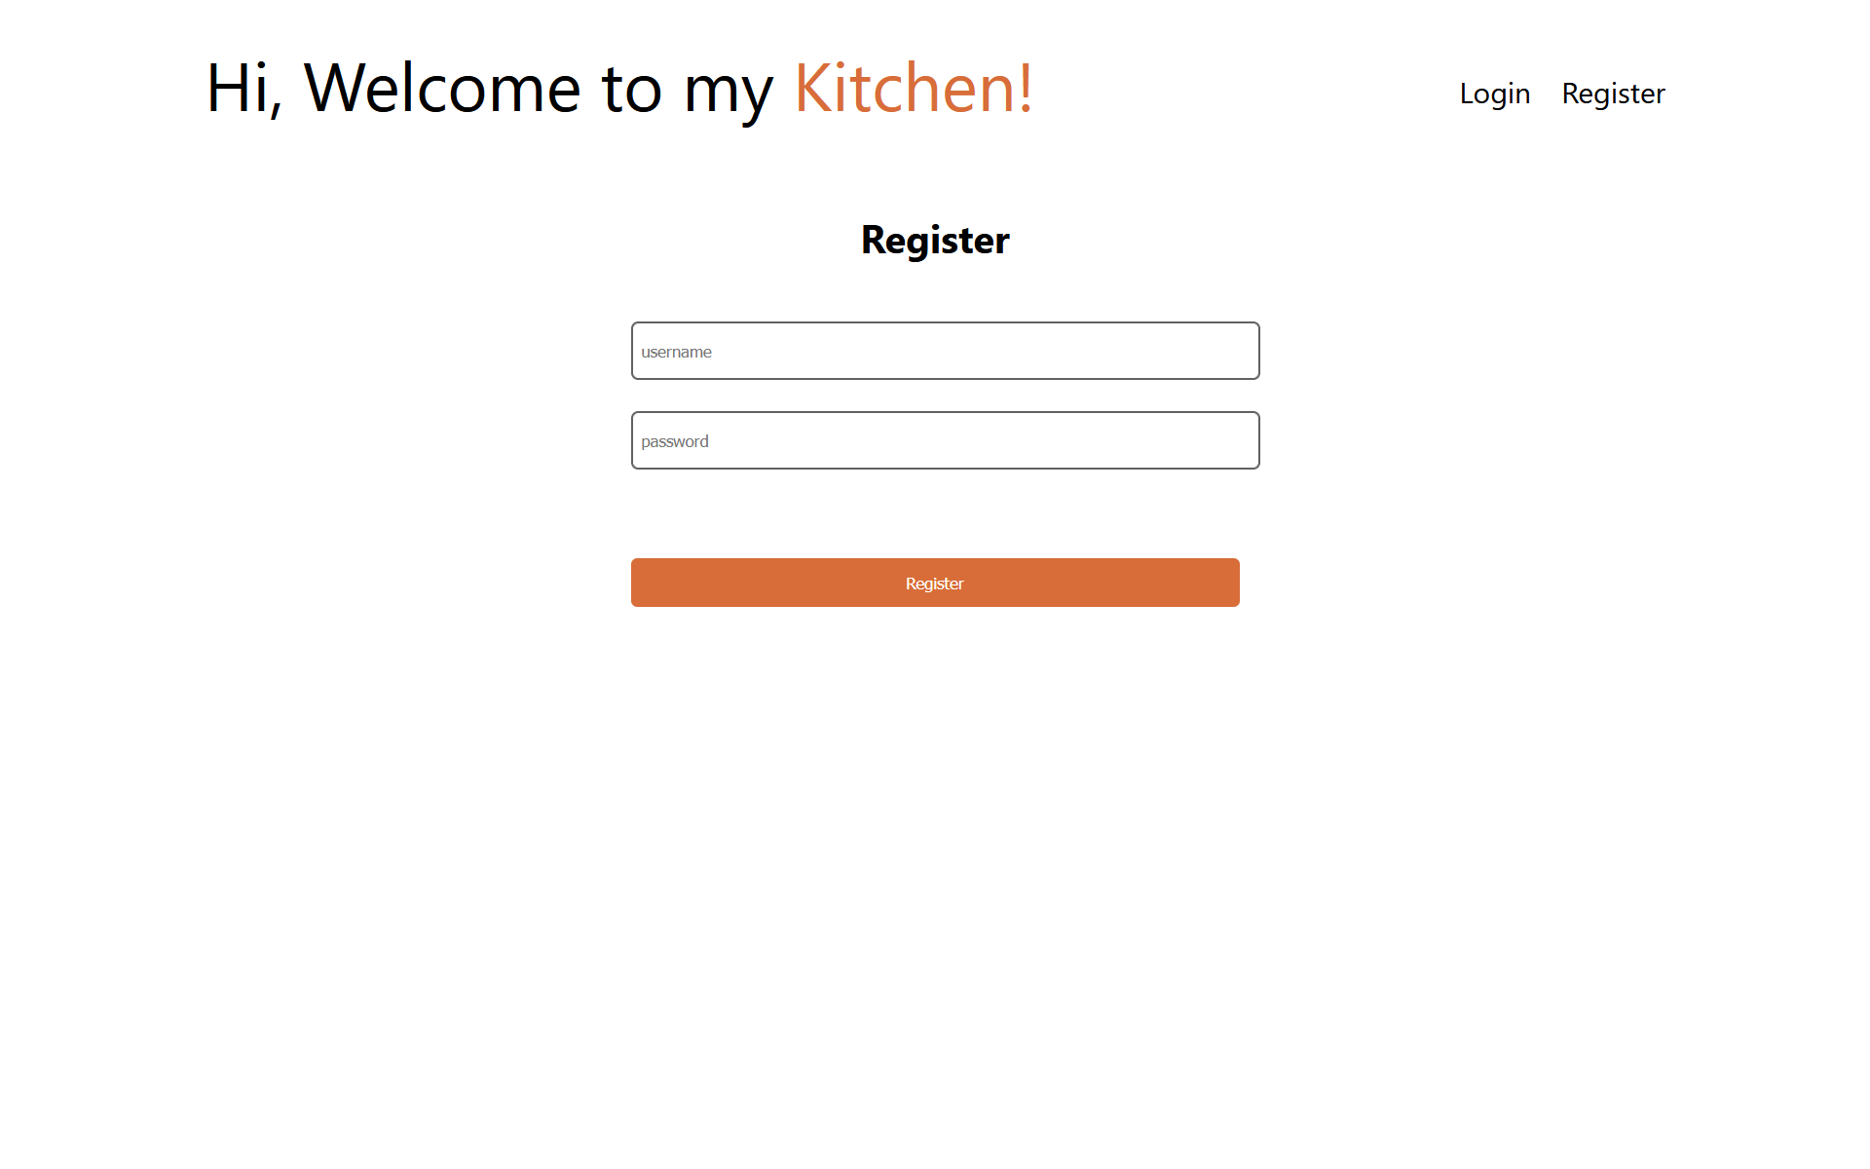
Register Page

Slide 9
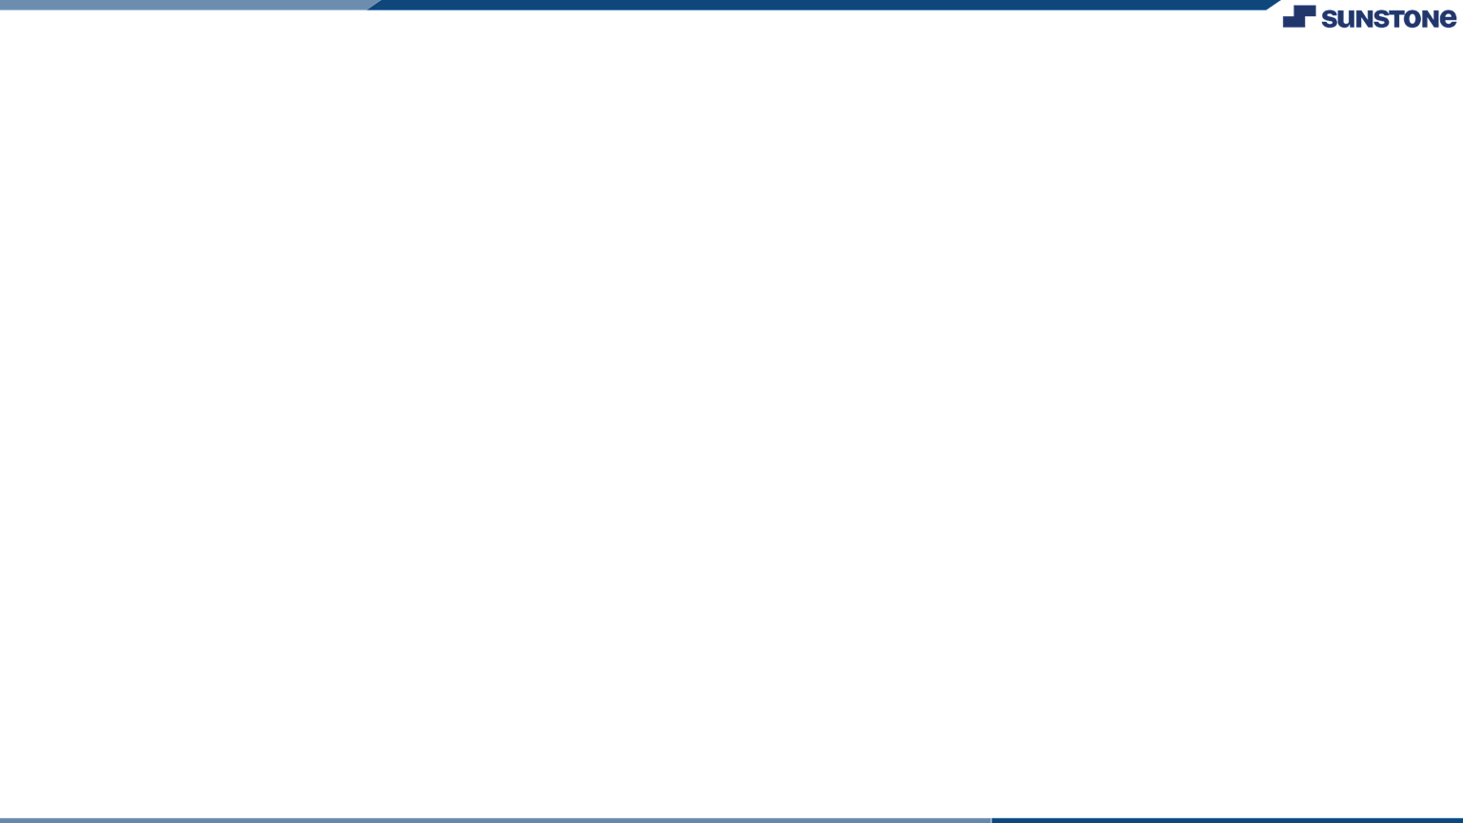

Assessment Parameter
Create folder structure for
React application
Render Conditional
components
Write Functions for event handling
Check-List
Overall UI of the project
Use props to pass variables
Handling broken links
Use ApI calls for data
Optimizing render cycle

Slide 10


Submission Github
https://github.com/Jhankit10/Food_Blog_Website

Slide 11


